Slide 1
MEASURING THE PULSE OF PROSPERITY :
AN INDEX OF
ECONOMIC FREEDOM ANALYSIS.

Slide 2
1. INTRODUCTION
overview
Measuring the Pulse of Prosperity: An Index of Economic Freedom Analysis" is a report
that aims to measure the level of economic freedom of different countries around the world.
Economic freedom is defined as the ability of individuals to engage in economic activities
without interference from the government or other external forces. The report uses a
comprehensive set of criteria to evaluate the economic freedom of each country, including
factors such as property rights, taxation, government spending, and labor market regulations.
By analyzing these factors, the report aims to provide insights into the economic health and
potential of each country, as well as inform policy decisions regarding economic reform and growth.
Measuring the pulse of prosperity is a process of evaluating the economic health and well-being
of a country. One tool used for this analysis is an index of economic freedom. This index measures
various factors such as: property rights, government spending, monetary freedom, trade freedom,
business freedom, and labor freedom. The scores are then combined to create a composite score,
which is used to rank countries in terms of their level of economic freedom. A higher score indicates
greater economic freedom, which is typically associated with higher levels of prosperity, economic
growth, and greater individual opportunities. This type of analysis is often used by policymakers,
investors, and businesses to assess the attractiveness of various countries for investment, trade,
and economic development.

Slide 3
Purpose
The purpose of using an index of economic freedom analysis is to measure the level of economic
freedom in a country and use this information to make informed policy decisions to promote economic
growth and prosperity. The index of economic freedom analysis can help identify areas where a country’s
economy is underperforming due to government interference, inefficient regulations, and other factors
that limit individual economic freedom. Through this analysis, policymakers can assess the strengths and
weaknesses of their economic policies, make changes, and identify opportunities to promote economic
growth by increasing economic freedom.Moreover, the index of economic freedom analysis can help a
country attract foreign investments by demonstrating its commitment to economic freedom and fostering
a business-friendly environment. It can also promote international trade and cooperation by providing a
common language for countries to discuss shared economic objectives and create frameworks for
cooperation. In summary, using an index of economic freedom analysis can assist policymakers to make
informed decisions on economic policies, promote economic growth, and attract investments to the country.

Slide 4
Problem Defining and Design Thinking
Empathy Map
Empathy maps are useful tools for understanding how different stakeholders perceive and engage with a
particular concept or issue. Here is an empathy map for measuring the pulse of prosperity using an index of
economic freedom analysis.
Users: Policymakers, Business leaders, Investors, Academics, Media
2. What they think: Policymakers might think in terms of economic indicators such as GDP growth,
unemployment rates, and inflation. Business leaders might focus on market opportunities, regulatory frameworks,
and competition. Investors might look for profitable investment opportunities, reliable estimates of risk, and
potential for return. Academics might be interested in understanding the economic base of the country, its
competitive sectors, and its regional disparities. Media might analyze the policy decisions and current events that
impact a country's economic prospects.
3. What they see: Policymakers see data visualizations, reports, and analysis
of economic indicators that show the state of the economy. Business leaders see market trends, news reports, and
investment opportunities. Investors see economic forecasts, risk assessments, and company performance reports.
Academics see research papers, case studies, and statistical data sets. Media see news stories, social media
discussions, and political decisions that impact the economy.
4. What they say and do: Policymakers might say, "We need policies that promote economic growth and job creation,“
"We need a clear regulatory framework that encourages competition and innovation," "We need reliable data
and analysis to make informed investments,"

Slide 5
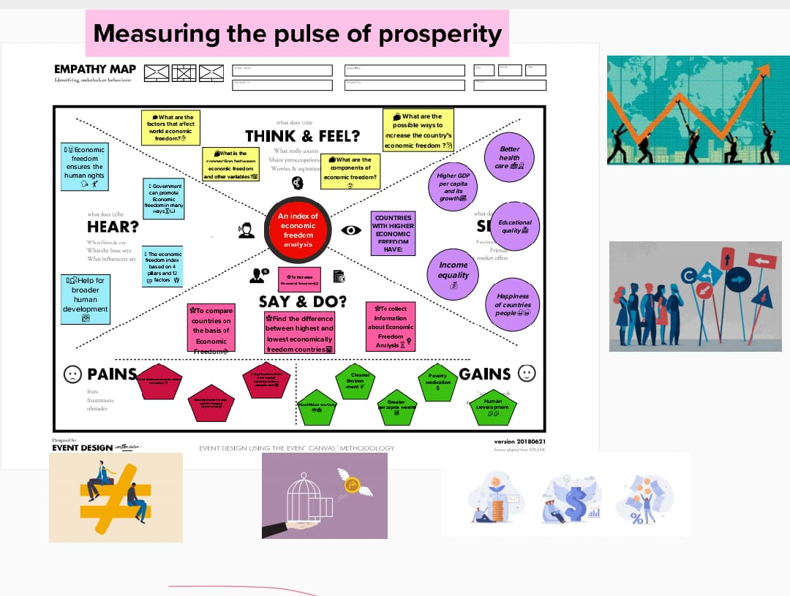

Slide 6
IDEATION AND BRAINSTORMING
Conduct a survey among businesses and individuals to understand their perception of economic
freedom in their country or region. Use the results to gauge the level of economic freedom in the
country and to identify areas that may require improvement.Create an index of economic freedom
that ranks countries or regions based on factors such as property rights, free trade, government regulation,
and the rule of law. This index could be updated regularly to provide ongoing insights into economic freedom
across the world.Analyze economic data such as GDP, employment rates, and inflation levels, and correlate
them with economic freedom rankings to identify trends and patterns. This could be used to inform government
policy and business decisions.Conduct case studies of countries or regions that have experienced significant
changes in economic freedom, either positive or negative, to understand the impact of these changes on
economic and social outcomes.Utilize machine learning algorithms to analyze economic data and identify
patterns and correlations that may not be apparent in traditional analysis methods. This could provide new
insights into the relationship between economic freedom and prosperity.Conduct focus groups among different
demographic groups to gain insights into how economic freedom affects their lived experiences and to inform
policy decisions that are more inclusive and equitable.Partner with academic institutions to conduct research
and produce reports that inform policymakers and the public about the impact of economic freedom on
prosperity and social outcomes. This could include case studies, data analysis, and policy recommendations.
Develop an online platform that enables individuals and businesses to track economic freedom in real-time,
and to provide feedback and suggestions for improvements.

Slide 7
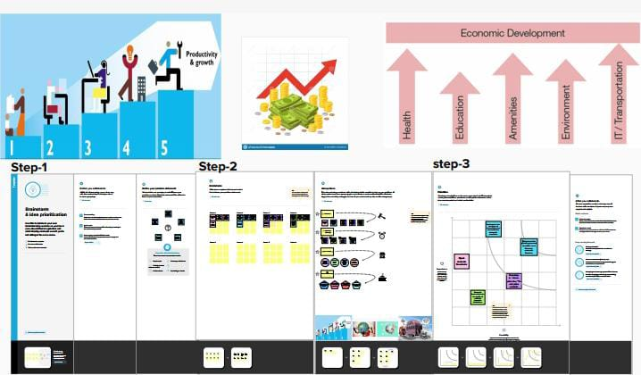

Slide 8
RESULT
The final output of "Measuring the Pulse of Prosperity: An Index of Economic Freedom Analysis" is a comprehensive ranking and analysis of the levels of economic freedom in countries around the world. The analysis includes data on measures such as property rights, government spending, trade policies, and regulation of business, among others. The rankings are based on a scale from 0-100, with higher scores indicating greater economic freedom. The overall aim of the analysis is to provide policymakers, researchers, and businesses with a tool for assessing the economic environment in different countries and identifying areas for improvement.

Slide 9
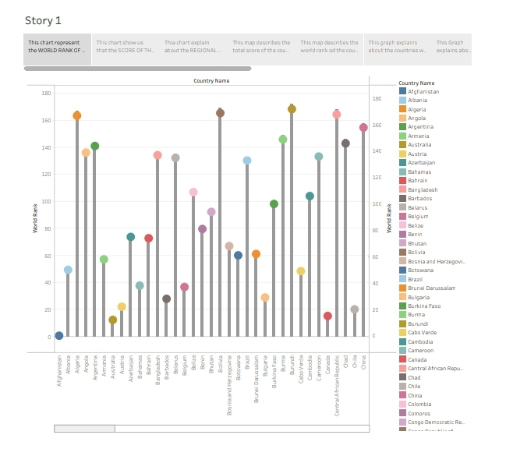

Slide 10
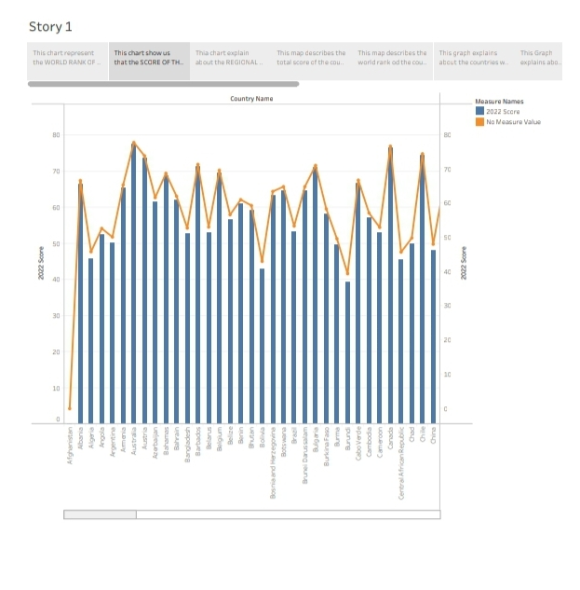

Slide 11
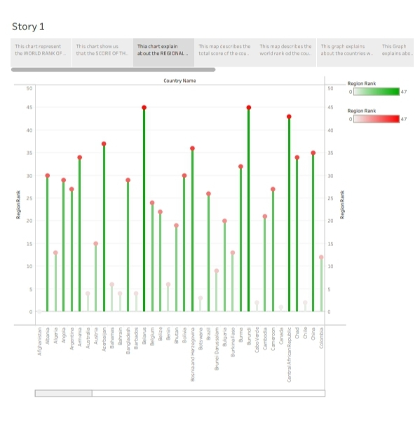

Slide 12
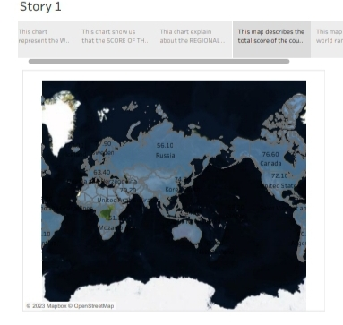

Slide 13
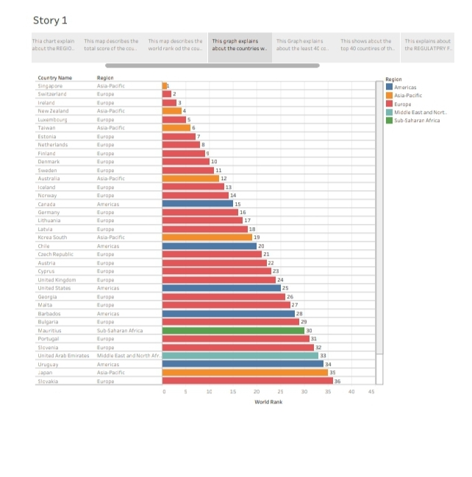

Slide 14
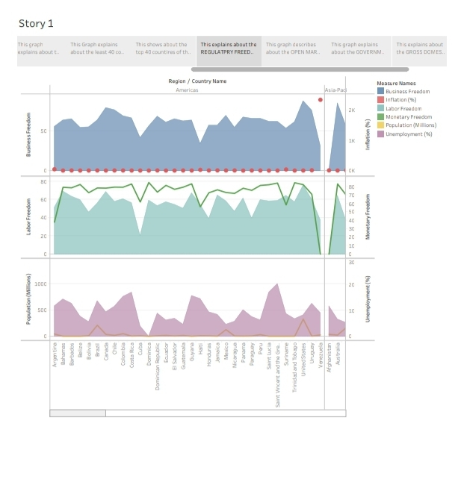

Slide 15
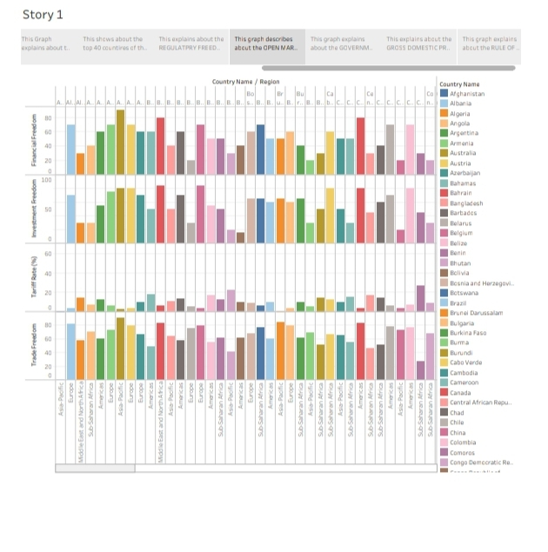

Slide 16
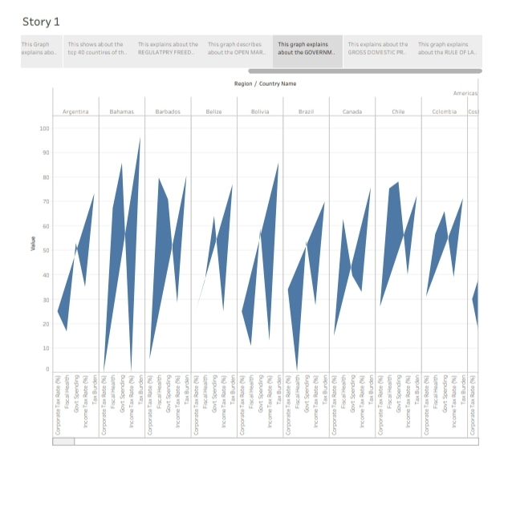

Slide 17
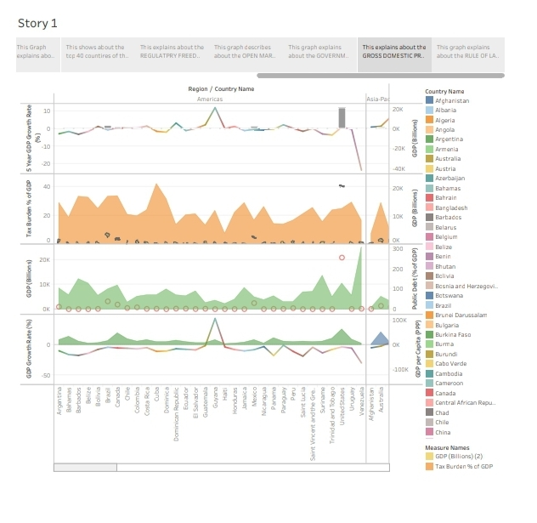

Slide 18
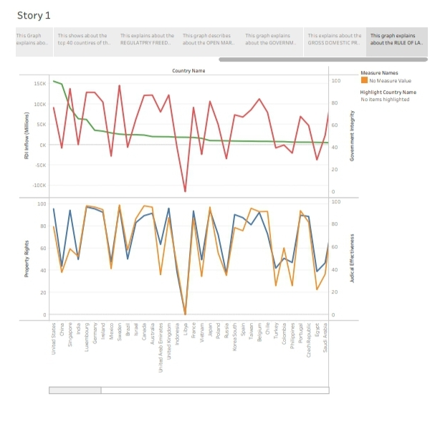

Slide 19
ADVANTAGES
1. Provides a comprehensive ranking: The index of economic freedom provides a ranking of economic
freedom in countries around the world. This provides policymakers and investors with a clear understanding
of the economic situation in different countries.
2. Helps in decision making: The index helps businesses indecision-making by identifying countries that have
a favorable business environment. It also assists policymakers in benchmarking their countries against others
and identifying areas that require policy interventions.
3. Identifies key factors that contribute to economic freedom: The analysis provides key factors that contribute
to economic freedom in a country, thus helping policymakers target areas that need improvement to
enhance economic freedom.
4. Promotes economic growth: The index promotes economic growth by creating a friendly business environment,
attracting foreign investment and generating employment opportunities.

Slide 20
DISADVANTAGES
Limited scope: The index has a limited scope and only measures economic freedom. It does not consider social indices like human development.
Subjectivity: There is a possibility of subjectivity when measuring economic freedom. Different organizations may have different opinions about what constitutes economic freedom.
Data limitations: The index uses data from a limited number of sources and does not account for other factors that
may impact economic freedom.

Slide 21
APPLICATIONS
1. Policy formulation: The index can be used by policymakers to benchmark their countries’
performance and identify areas that require policy interventions.
Investment decision-making: Investors can use the index to identify countries that have a
favorable business environment, making them attractive for investment.
3. Academic research: Researchers can use the index to study the relationship between economic
freedom and other economic indicators like GDP, FDI, and employment.

Slide 22
CONCLUSION
In conclusion, the index of economic freedom is an essential tool for analyzing economic freedom
in different countries. It provides policymakers, investors, and researchers with a clear understanding
of the economic situation in different countries. The index helps in decision-making, promotes
economic growth, and identifies key factors that contribute to economic freedom. However, there are
limitations to the scope, subjectivity, and data used for the analysis.

Slide 23
FUTURE SCOPE
The index of economic freedom analysis can be further enhanced in the future by considering
social indices like human development, using a more diverse set of data sources, and reducing
subjectivity in the analysis. Further research could also be done to study the correlation between
economic freedom and other economic indicators.

Slide 24
THE END

